Slide 1
Artificial Intelligence for Learning
How AI can revolutionize learning

Slide 2


Slide 3


Slide 4


ChatGPT
A generative artificial intelligence that can conversate with students to promote their learning

Slide 5

Personalization

Slide 6
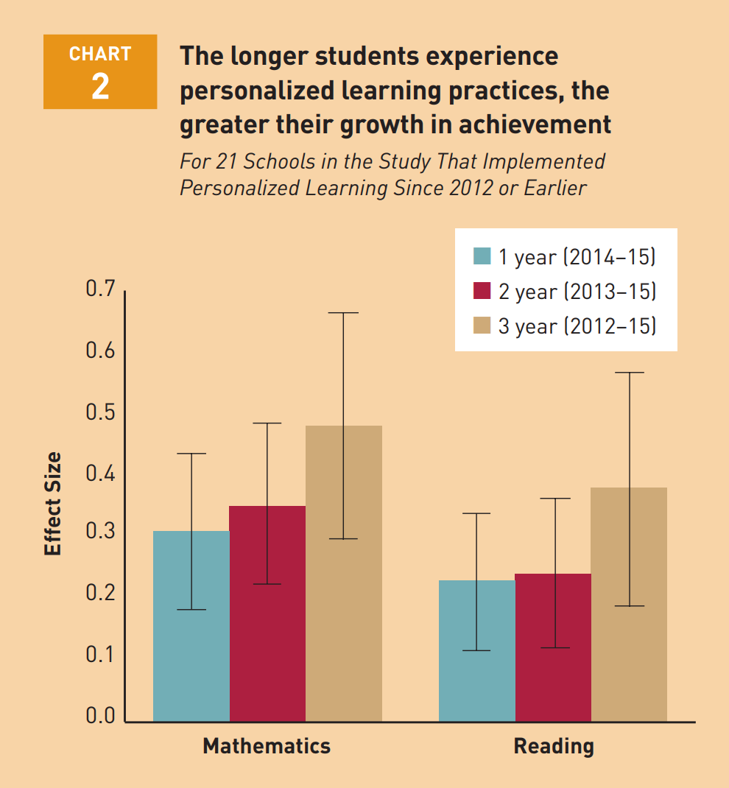
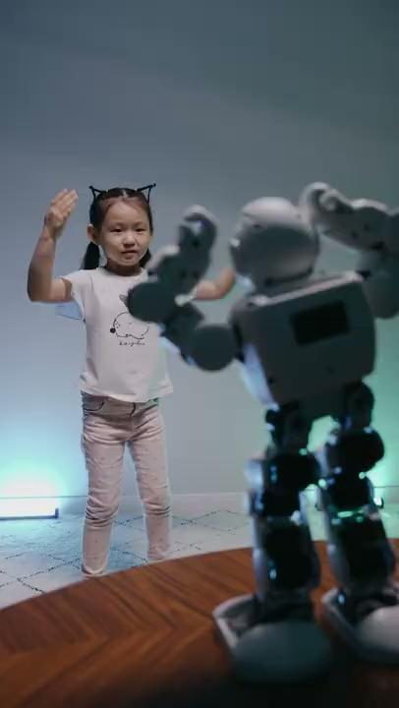
Faster learning
And the longer the personalized learning lasts, the faster the learning goes!
(Pane et al., 2015)

Slide 7

Intellectual skills

Slide 8





ChatGPT can foster…
Critical thinking
Problem solving
(World Economic Forum, 2016)

Slide 9

How does ChatGPT foster intellectual skills?
Notes:
Slides 9 and 10 should be treated as one slide.

Slide 10

How does ChatGPT foster intellectual skills?
Notes:
Slides 9 and 10 should be treated as one slide.

Slide 11

In a nutshell…
Notes:
Slides 11 and 12 should be treated as one slide.

Slide 12

In a nutshell…
Notes:
Slides 11 and 12 should be treated as one slide.

Slide 13
Thanks for listening

Slide 14
Bibliography
Pane, J. F., Steiner, E. D., Baird, M. D., & Hamilton, L. S. (2015). Continued progress: Promising evidence on personalized learning. RAND Corporation.
World Economic Forum (2016). The Future of Jobs: Employment, Skills and Workforce Strategy for the Fourth Industrial Revolution. Global Challenge Insight Report.

